Slide 1
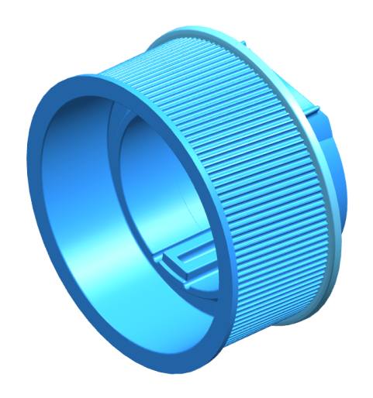
Next Gen Plastic Pulley Development
Description
Development of a plastic pulley to become CBOD on Future REPS gears
Implement lessons learned from C1XX Plastic Pulley development
Next Gen Design: Full Round ID: Removing C1XX ID scallop it will improve tooth from roundness and run-out and may help us eliminate the need to machine ID
Investigate Non DSM Materials to minimize effects of deformation due to shrinkage
Investigate Phenolic resin to determine if it can improve dimensional control without excessive cost.
High Risk: brittle nature in tension adds risk to design since press-fit on ID is required (Supplier running FEA on this now)
Optimize Belt Interaction
Deep tooth profile is mainstream
Can be designed for Gates or Dayco belt (per program direction)
Status
Design Being Finalized now for implementation into T1XX
Will begin working with multiple suppliers and will select the top two suppliers as a dual path for development. This will avoid another Viking situation
Team Member/Customers
Kevin McClendon / Nik von Matt

